Slide 1
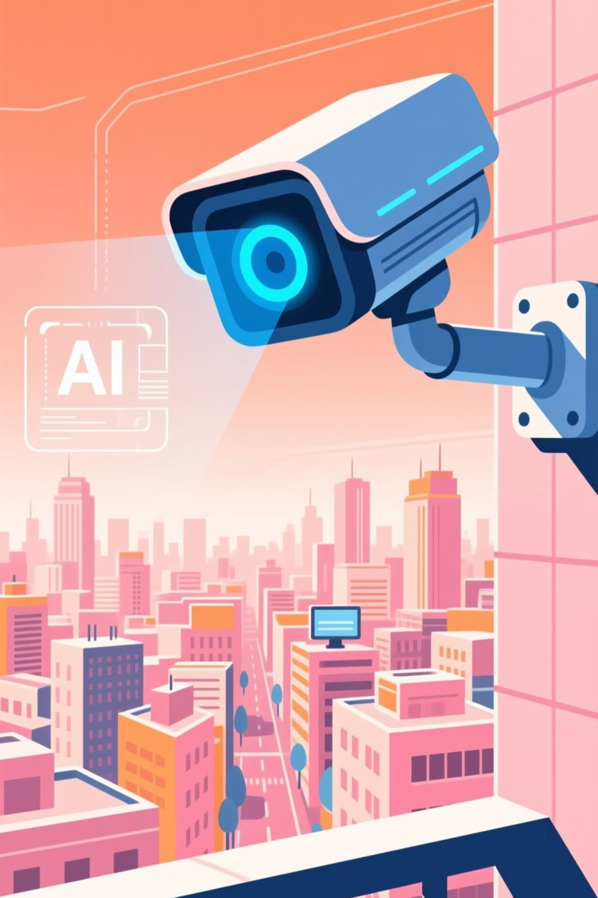
Garuda Eye: Revolutionizing Security with AI
Transforming reactive security into proactive protection for a safer world.

Slide 2




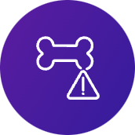



The Urgent Reality
Security's Blind Spots
Slow & Error-Prone
Missed Threats
Manual CCTV monitoring is inherently inefficient, leading to critical delays and missed incidents.
Human operators frequently fail to identify subtle but dangerous threats like weapons or fights.
High Stakes
Costly Operations
Delayed detection can result in severe consequences: injuries, property damage, or even loss of life.
The sheer manpower required for effective manual surveillance drives up operational costs significantly.

Slide 3
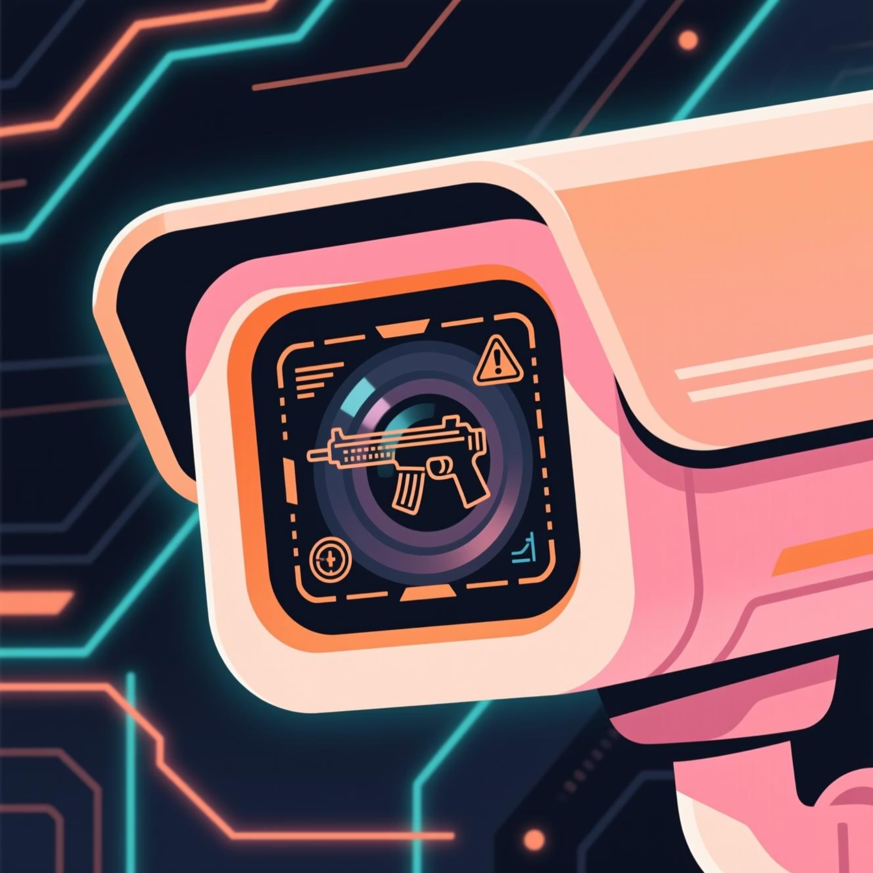
Introducing Garuda Eye
Intelligent Automation for Real-Time Threat Detection
Garuda Eye is an AI-powered CCTV monitoring system that transforms surveillance from passive observation to proactive threat neutralization. It automatically detects critical events and sends instant alerts.
Key Differentiators:
Comprehensive Detection: Identifies weapons, violence, abusive language, and sensitive activities.
Configurable Sensitivity: Users define alert thresholds from low (weapons only) to high (abuse, aggression, blood).
Secure & Future-Proof: Built on a secure data ecosystem with quantum-safe encryption.

Slide 4
Core Capabilities
Garuda Eye's Feature Set
🔍 AI Vision: Real-time Threat Detection
🗣️ Abuse Monitoring: Intelligent Audio Analysis
Utilizes advanced Computer Vision to identify weapons, instances of violence, and signs of aggression or blood.
Leverages Natural Language Processing (NLP) to detect and flag offensive or abusive language in monitored environments.
⚙️ Custom Sensitivity: Tailored Alert Thresholds
📲 Instant Alerts: Immediate Notification System
Empowers users to customize alert sensitivity, ensuring relevance for diverse operational needs and scenarios.
Delivers real-time notifications to designated personnel—facility owners, security staff, or emergency services.
🔐 Secure Data: Encrypted Ecosystem
⚡ Quantum Layer: Future-Proof Protection
Ensures data integrity and privacy through a robust, encrypted storage and dashboard infrastructure.
Integrates a quantum-safe encryption layer, optimizing security and safeguarding against future cyber threats.

Slide 5








Transformative Outcomes
Impact & Benefits of Garuda Eye
Enhanced Safety
Broad Scalability
Accelerated threat detection drastically reduces incident response times, preventing crimes and minimizing harm.
Adaptable for diverse environments: schools, shopping malls, corporate campuses, and expansive smart city infrastructures.
Profound Social Impact
Unmatched Customization
Creates genuinely safer environments for vulnerable populations, children, and the public at large.
The sensitivity slider allows precise tailoring to specific use-cases and varying security requirements.

Slide 6



Alignment with D3CODE 2025
Synergy with Tomorrow's Tech Landscape
Quantum Security
Implementing quantum encryption ensures future-proof data security against evolving cyber threats.
Secure Data Ecosystems
Robust, scalable dashboards and APIs form a reliable foundation for data management.
Advanced AI Integration
Leveraging Computer Vision and Natural Language Processing for intelligent and adaptive threat detection.

Slide 7
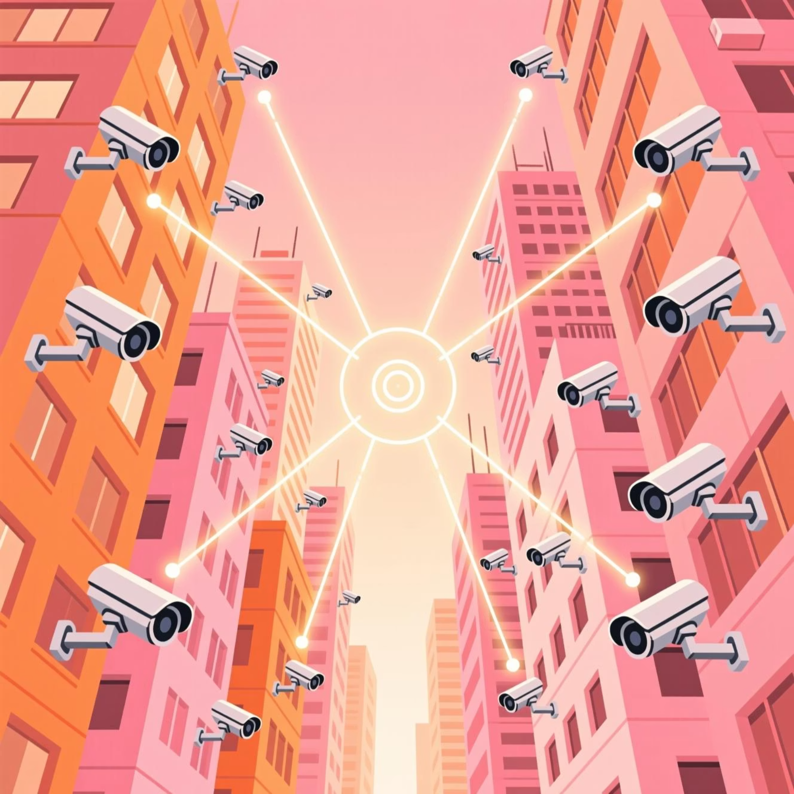
Unmet Demand
Validating the Market Need
Massive Surveillance Gap: India alone has over 10 million CCTV cameras, yet more than 95% still rely on inefficient manual monitoring. This creates a critical vulnerability.
Escalating Safety Concerns: Growing societal anxieties around school safety, women's safety, and rising urban crime rates underscore the urgent need for smarter security.
Outdated Solutions: Current market offerings lack crucial AI-driven intelligence and the ability to customize sensitivity, leaving significant gaps in effective threat detection.

Slide 8

Competitive Edge
Why Garuda Eye Leads the Market
Current Players
The Gap We Fill
While some competitors like Actuate AI and Veesion offer specialized security solutions (e.g., retail), they fall short in comprehensive, integrated capabilities.
No existing solution provides the critical combination of features that Guardian Eye offers.
1
2
3
Custom Sensitivity Thresholds
Integrated CV + NLP
Quantum-Secure Data Protection
Seamless combination of visual and linguistic intelligence for a holistic understanding of potential threats.
Unparalleled control over alert parameters, allowing for precise, scenario-specific threat detection.
Future-proof encryption safeguards sensitive data against even the most advanced cyber threats.

Slide 9
Technological Foundation
The Power Behind Garuda Eye
AI (Computer Vision)
YOLOv8, OpenCV, TensorFlow
AI (Natural Language Processing)
Whisper (speech-to-text), BERT/RoBERTa (abuse detection)
Backend
Python (FastAPI/Flask), Node.js
Frontend
React.js / Flutter (Alerts Dashboard)
Database
PostgreSQL / MongoDB
Infrastructure
Docker, Kubernetes, Cloud Platforms
Quantum Integration
Qiskit (for encryption demo)

Slide 10




Future Horizons
Garuda Eye's Strategic Roadmap
Phase 1: Initial Deployment
Phase 2: Smart City Integration
Targeting controlled environments: schools, malls, and corporate offices.
Seamlessly integrate Guardian Eye into broader urban smart city ecosystems.
Phase 3: Predictive AI Enhancement
Phase 4: Global Standardization
Develop and implement advanced AI models for early detection of aggressive behaviors.
Scale Guardian Eye internationally, establishing it as the global benchmark for AI-driven safety systems.

